Slide 1

Visvesvaraya National Institute of Technology
Model development and analysis of impact of community mobility during COVID-19
Group Members:
BT17MEC24- B. Ajay
BT17MEC29- Devaunsh Ghatoley
BT17MEC53- Tejas Mulay
Project Guide:
Dr. Avinash Thakre

Slide 2
Introduction
Amid the pandemic COVID-19, the Indian economy saw an immense deviation from the regular value under normal conditions.
The negative impact was due to-
  Restrictions on transport of goods during lockdown.
  Effect of illness on employees
  Irregularities in demand-supply of goods
  Psychological impact on population

Slide 3
Objectives
The following are the objectives of the project as discussed:
  Identifying the parameters that affect the spread of disease
  Analysing the regions affected the most during the pandemic
  Economic impact on local businesses in different regions
  Devising a structured lockdown implementation
  Impact of community mobility on variation in number of cases
  Developing a model from COVID19 to handle future outbreaks

Slide 4
Timeline
September
Explored domains and project selection
October
Study of data Analysis and data acquisition
November
Study of data Analysis and data acquisition
December
Data mining and cleaning and analyzing
April
Developing a theoretical
March
Identifying Correlation
February
Developing a mathematical model
January
Analysing state wise data

Slide 5
Literature Review
Title: Lockdown for COVID-19 and its impact on community mobility in India
Author: Jay Saha
Review:
The paper studies lockdown imposition in various region in the country based on the community mobility data and provides theoretical insights into its implementations. It analyses the impact of lockdown on community mobility using spatial time-series changes over different states and union territories (UTs) of India.
Title: A Comprehensive Analysis of COVID-19 Outbreak situation in India
Author: Rajan Gupta
Review:
The paper studies strategies for continuation of lockdown based on discussion and database. It suggests that only essential services should be open for the citizens of India in the national lockdown and provides future strategies for the same.

Slide 6
Literature Review
Title: Exploratory Data Analysis of COVID-19 in India
Author: Sarvam Mittal
Review:
The paper studies and analyses the COVID-19 spread in India since the day of outbreak and pattern of spreading of virus in India and to understand why National and local authorities are having a difficult time in dealing with the COVID-19. It suggests the implementation strategies to be followed for minimal spread of disease.
Title: COVID-19 Epidemic: Unlocking the Lockdown in India
Author: Rajesh Sundaresan
Review:
The paper studies and presents the outcomes of a city-scale simulation experiments that suggest how the disease may evolve once restrictions are lifted. It studies the impact of case isolation, home quarantine, social distancing of the elderly, school and college closures, closure of offices, odd-even strategies, etc., as components of various post-lockdown restrictions that might remain in force for some time after the lockdown is lifted.

Slide 7
Assumptions
Restriction on mobility of communities led to severe impact on local economy.
Lockdown procedures were implemented in different fashions in different regions of the country, with varying outcomes in all of the said regions.
We also assume that airborne disease with similar contagiousness may return in the future.
As the restrictions imposed are varying region wise, we think there is a certain set of guidelines that can be followed for a successful lockdown to be implemented.
The mutated virus was brought into India around mid-January 2021, and along with it brought disparities in the data analysis.
So only data upto 19th January 2021 is considered for model preparation.

Slide 8
Methodology
Data Parameters
Data Acquisition
Data Dissemination
Insights
Data Visualization
Exploratory data analysis

Slide 9
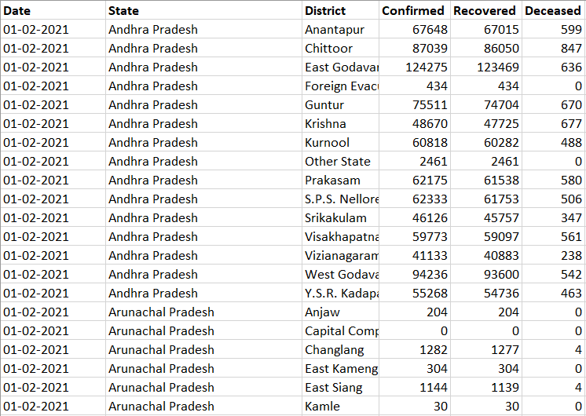
Data Collection
Source:
covid19india.org

Slide 10
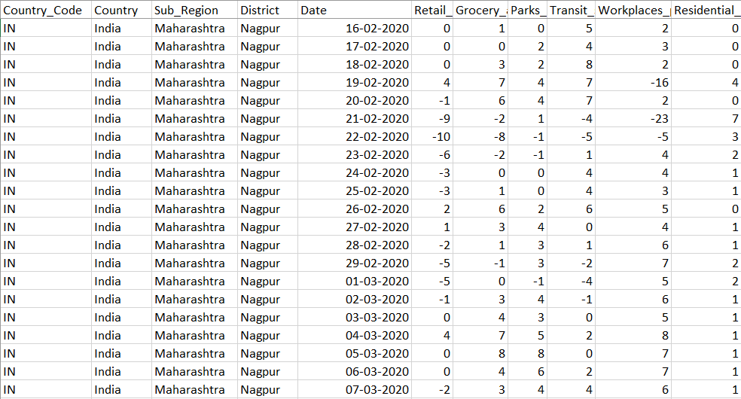
Data Collection
Source: Google Maps Community Mobility Data

Slide 11
Data Understanding
  Google Maps Community Mobility Data
  Generalization of data:-
  Timeline
  Grocery shops
  Retail shops
  Parks
  Workplaces
  Residential
  Transit Spots
Parks | Transit stations
Public garden | Subway station
Castle | Sea port
National forest | Taxi stand
Camp ground | Highway rest stop
Observation deck | Car rental agency

Slide 12
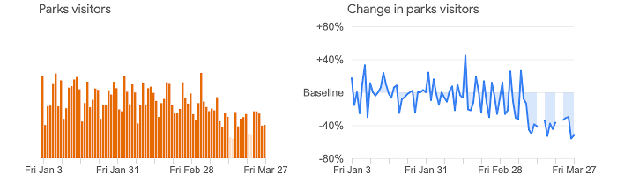
Data Understanding
Google Maps Community Mobility Data
Baseline:
The data shows how visitors to (or time spent in) categorized places change compared to our baseline days. A baseline day represents a normal value for that day of the week. The baseline day is the median value from the 5‑week period Jan 3 – Feb 6, 2020.

Slide 13
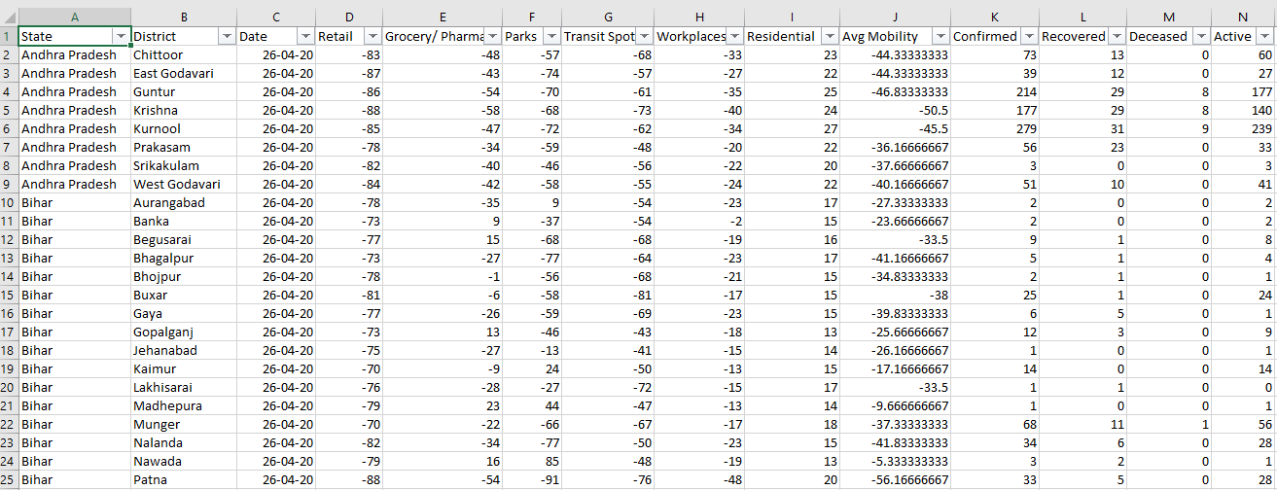
Merging Data Sets
Data sets were merged by inner join in Tableau based on Date, State and District.

Slide 14
Aspects of Analysis
Economic Aspect
Community Mobility Data
Psychological Aspect
Acceptance and reaction
Impact Analysis
Region-wise Impact
Implementation Strategies (Lockdown)

Slide 15
Lockdown Phases
Nationwide lockdown:
Phase 1: 25 March 2020 – 14 April 2020 (21 days)
Phase 2: 15 April 2020 – 3 May 2020 (19 days)
Phase 3: 4 May 2020 – 17 May 2020 (14 days)
Phase 4: 18 May 2020 – 31 May 2020 (14 days)
Unlock:
Unlock 1.0: 1– 30 June 2020 (30 days)
Unlock 2.0: 1– 31 July 2020 (31 days)
Unlock 3.0: 1– 31 August 2020 (31 days)
Unlock 4.0: 1 - 30 September 2020 (30 days)
Unlock 5.0: 1 - 31 October 2020 (31 days)
Unlock 6.0: 1 - 30 November 2020 (30 days)
Unlock 7.0: 1 - 31 December 2020 (31 days)

Slide 16
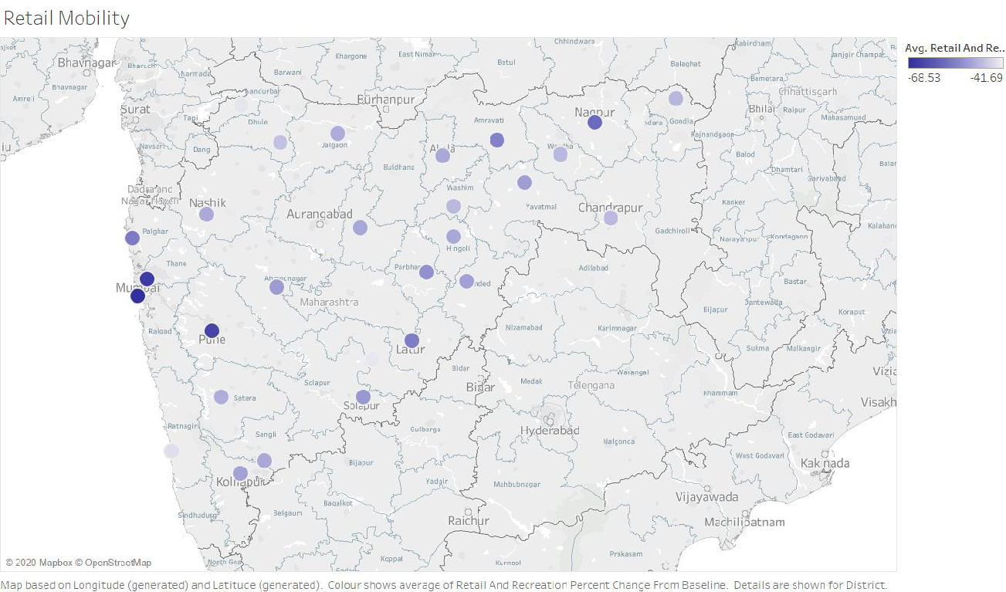
Exploratory Data Analysis
The regions with dark blue colour represent a negative deviation from baseline i.e. less people visiting a particular region than the usual number and vice versa or the light shades with a linear variation. The average value being considered is based on the timeline from March to September of all the spots in a region

Slide 17
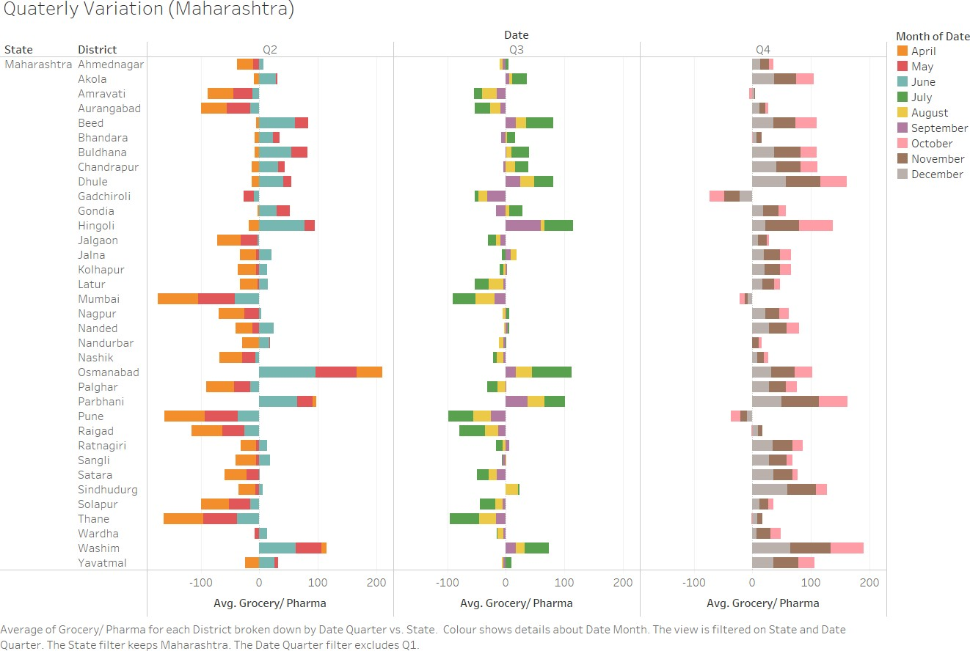
Exploratory Data Analysis
It is evident that in quarter-2 the restrictions imposed were strictly followed and resulted in less mobility. Whereas, in the other two quarters the fluctuation observed tend to result in failure of social distancing and thus spikes in number of cases in those particular region can be observed as its repercussions.
Quarter-2: Phase Lockdown
Quarter-3: Phase Unlock 1-2
Quarter-4: Phase Unlock 3-4

Slide 18
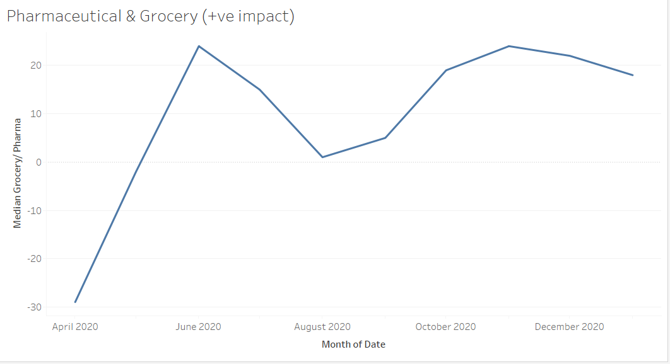
Economic Aspect
Groceries, pharmacies etc. were the only essential services running through the lockdown and unlock phases in a controlled manner. These businesses show positive growth supporting the economy during the pandemic.

Slide 19
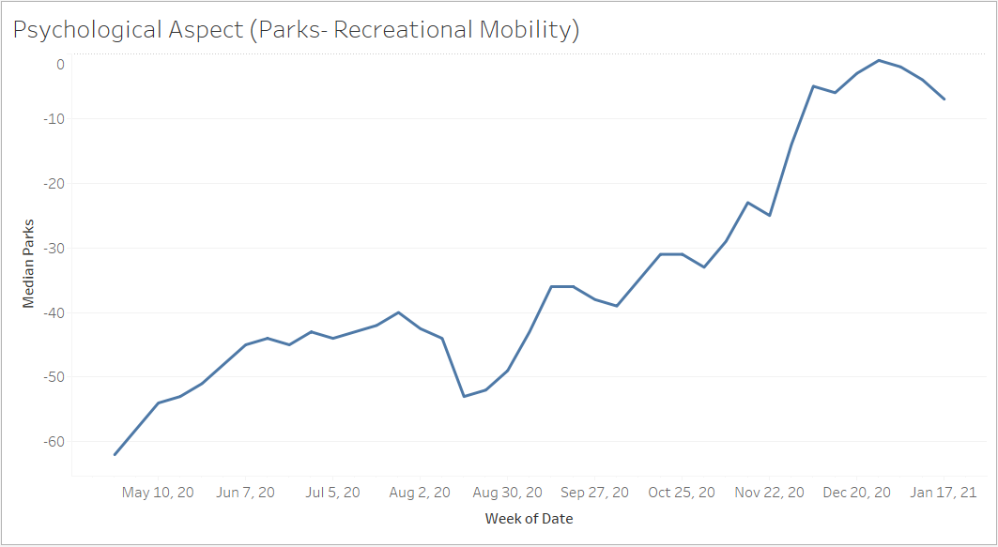
Psychological Aspect
This is the average mobility data of the entire country illustrating the patterns during the various lockdown and unlock phases that were followed throughout the country
The rise and fall around the month of December indicates the presence of the new mutated COVID-19 strain entering India.
Two trends we would like to discuss
Fall during Month of August
Fall during Month of December

Slide 20
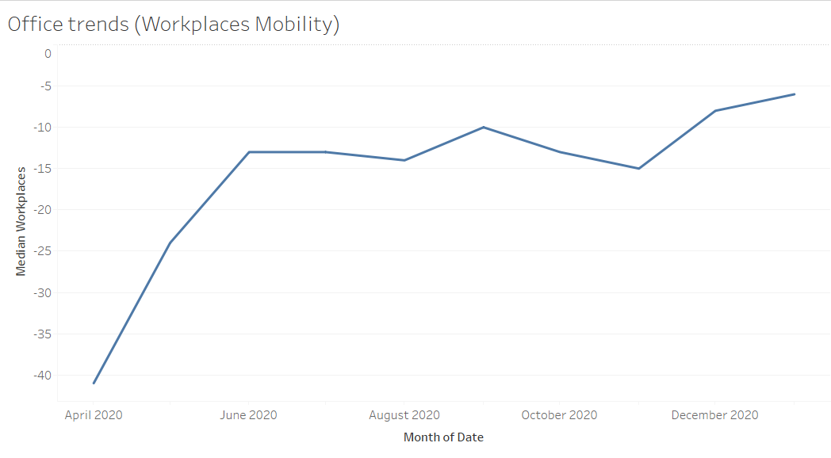
Impact Analysis
The impact of this pandemic has brought about various changes in different aspects of our society.
One that is majorly observed is the mobility of employees workplaces and offices.

Slide 21
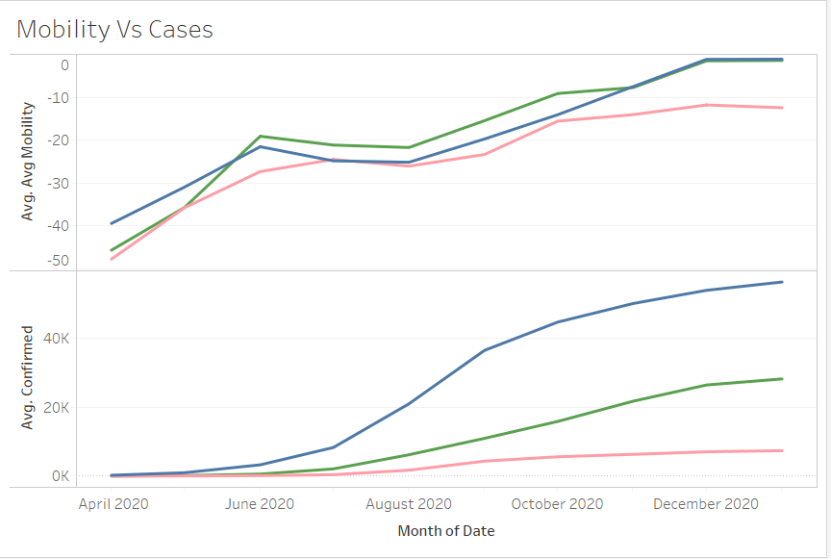

Relation between mobility and cases
We have considered 3 states here to showcase that even if mobility trends are similar, the varying lockdown procedures implemented were the reason some states were able to handle the pandemic better than the others.

Slide 22
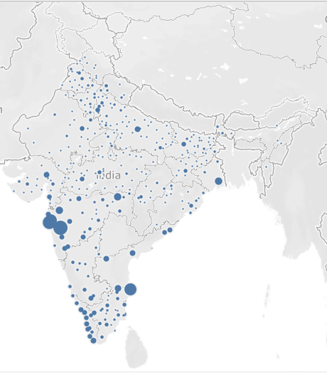
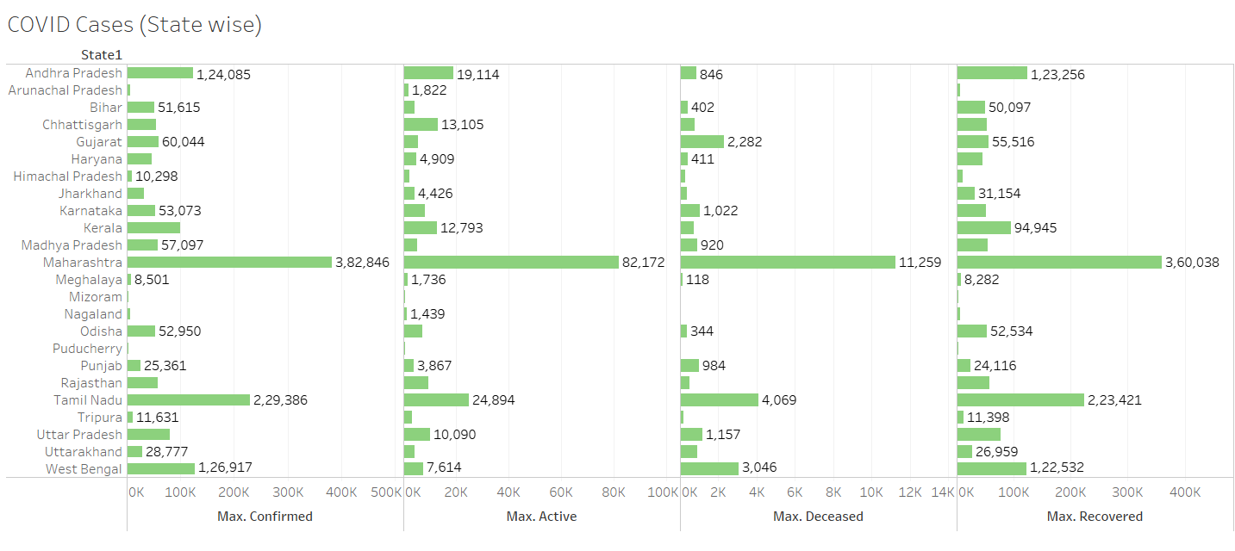
Confirmed Cases till 19th Jan

Slide 23
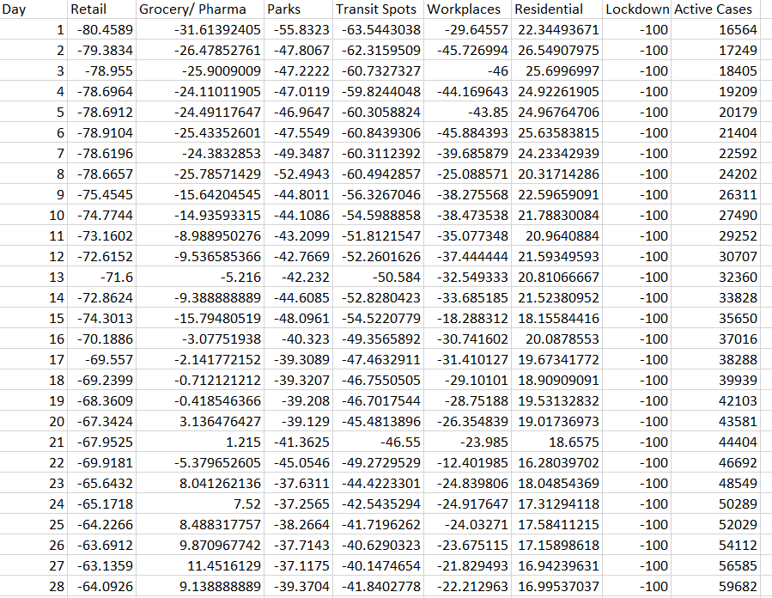
India Average Dataset
Lockdown Column denotes if lockdown was active(-100) or not (100).
Mobility Dataset to various amenities is average of all districts from all regions of India.
Active Cases denote total number of active cases throughout the country on the given day

Slide 24
Enumerated Data
State | Coded States | District | Coded Districts | Date | Day | Retail | Grocery/ Pharma | Parks | Transit Spots | Workplaces | Residential | Confirmed | Recovered | Deceased | Active
Andhra Pradesh | 1 | Chittoor | 1 | 43947 | 1 | -83 | -48 | -57 | -68 | -33 | 23 | 73 | 13 | 0 | 60
Andhra Pradesh | 1 | East Godavari | 2 | 43947 | 1 | -87 | -43 | -74 | -57 | -27 | 22 | 39 | 12 | 0 | 27
Andhra Pradesh | 1 | Guntur | 3 | 43947 | 1 | -86 | -54 | -70 | -61 | -35 | 25 | 214 | 29 | 8 | 177
Andhra Pradesh | 1 | Krishna | 4 | 43947 | 1 | -88 | -58 | -68 | -73 | -40 | 24 | 177 | 29 | 8 | 140
Andhra Pradesh | 1 | Kurnool | 5 | 43947 | 1 | -85 | -47 | -72 | -62 | -34 | 27 | 279 | 31 | 9 | 239
Andhra Pradesh | 1 | Prakasam | 6 | 43947 | 1 | -78 | -34 | -59 | -48 | -20 | 22 | 56 | 23 | 0 | 33
Andhra Pradesh | 1 | Srikakulam | 7 | 43947 | 1 | -82 | -40 | -46 | -56 | -22 | 20 | 3 | 0 | 0 | 3
Andhra Pradesh | 1 | West Godavari | 9 | 43947 | 1 | -84 | -42 | -58 | -55 | -24 | 22 | 51 | 10 | 0 | 41
Bihar | 3 | Aurangabad | 2 | 43947 | 1 | -78 | -35 | 9 | -54 | -23 | 17 | 2 | 0 | 0 | 2
Bihar | 3 | Banka | 3 | 43947 | 1 | -73 | 9 | -37 | -54 | -2 | 15 | 2 | 0 | 0 | 2
Bihar | 3 | Begusarai | 4 | 43947 | 1 | -77 | 15 | -68 | -68 | -19 | 16 | 9 | 1 | 0 | 8
Bihar | 3 | Bhagalpur | 5 | 43947 | 1 | -73 | -27 | -77 | -64 | -23 | 17 | 5 | 1 | 0 | 4
Bihar | 3 | Bhojpur | 6 | 43947 | 1 | -78 | -1 | -56 | -68 | -21 | 15 | 2 | 1 | 0 | 1
Bihar | 3 | Buxar | 7 | 43947 | 1 | -81 | -6 | -58 | -81 | -17 | 15 | 25 | 1 | 0 | 24
Bihar | 3 | Gaya | 9 | 43947 | 1 | -77 | -26 | -59 | -69 | -23 | 15 | 6 | 5 | 0 | 1
Bihar | 3 | Gopalganj | 10 | 43947 | 1 | -73 | 13 | -46 | -43 | -18 | 13 | 12 | 3 | 0 | 9

Slide 25
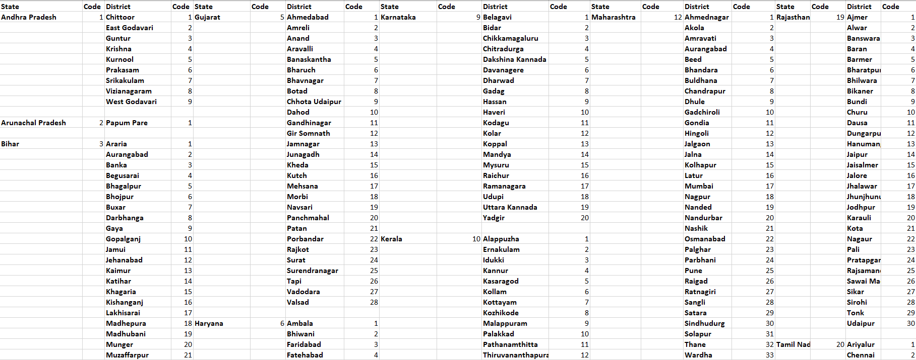
Enumeration Index

Slide 26
Input Data (Read into pandas Dataframe)
Exploratory Analysis of Data
(India Average Dataset)
Exploratory Analysis of Data on enumerated data
&
User selection of state and district
Decide Independent and dependent variables
Segregate test and train dataset
Fit the data into polynomial regression model
(Degree 1-10)
Optimal R-square value model selected

Slide 27
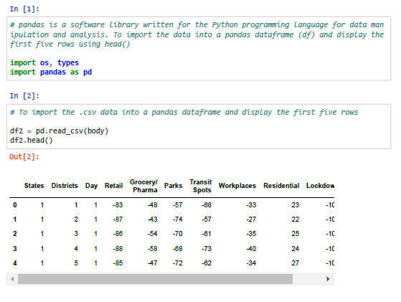
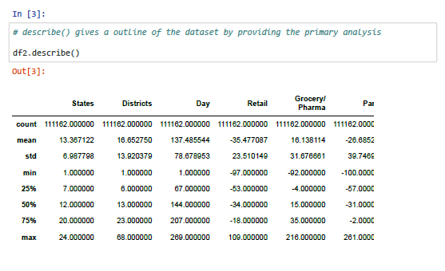
Python Code Incorporated

Slide 28
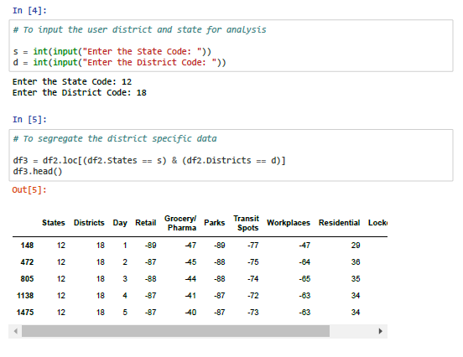
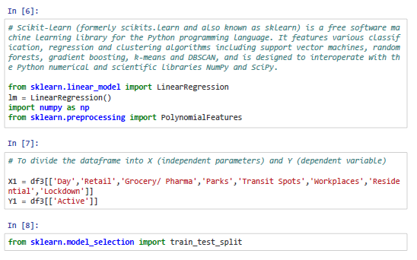

Slide 29
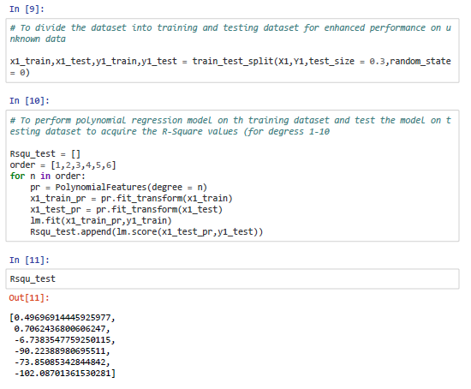
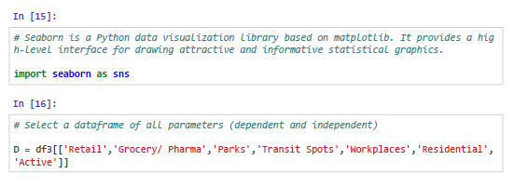
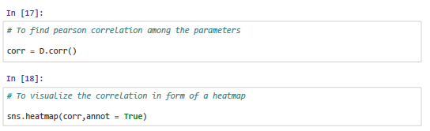
Max R-Square

Slide 30
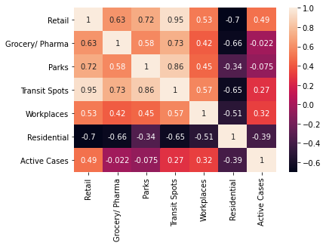
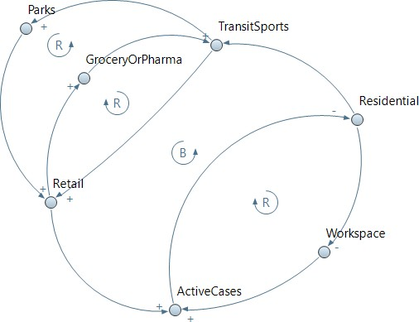
Co-relation Heatmap
Causal Loop Diagram

Slide 31
Theoretical Model
A theoretical model is proposed with well being of the society being the primary concern. The following are the points mentioned in the proposed model:
For containment zones within districts where spread of virus could not be controlled or people were not following the cited precautions sincerely, policies LD26-CI & LD40-CI are recommended to follow as per the severity of disease in the locality and the population density present.
LD26-PE- CI is recommended for states where the virus did not spread to or the authorities were able to contain the spread.
LD26-PE- SCCI is recommended for states where facilities require a buffer period to prepare to handle the outbreak, if population density is as compared to that of states in the earlier scenario, and if compliance of people is a concern which is contributing to spread of the virus.
LD26- PEOE-CI is recommended for states which are densely populated, spread of the virus is proving difficult to be managed, public is non complacent or trends of cases don’t seem to lower or be affected by the previous scenarios.

Slide 32
Results
  Economic Aspect
  The economic aspect in India can be observed with mobility at Groceries/ Pharma, Workplaces, and Retail stores. The fall in percentage of people visiting a business point directly impact the sales.
  As time progressed, the imposed restrictions were being phased off and businesses were allowed to function, which meant they were conducting business as usual, but the economy had not yet been restored as mobility trends are not back to pre-lockdown scenarios.
  States of Maharashtra & Andhra Pradesh show sudden change in mobility trends to Groceries and Pharmacies indicating unstable economic conditions
  States of Uttar Pradesh, Rajasthan & Punjab show the most positive trends to Groceries and Pharmacies indicating a normal cash flow in their economies.

Slide 33
Results
  Psychological Aspect
  Due to lack in conveying the phases of unlock, a havoc among the people resulted in ill-managed movement among the districts based on the density maps.
  The fall in mobility around December shows that people were accepting of the new strain being fatal and were taking the necessary steps before being intimated by the governing bodies
Impact Analysis
People were following restrictions imposed at the early stages of the pandemic, but as relaxation in these laws was brought, a pattern of carelessness and negligence could be observed as cases started to rise.
States of Maharashtra and Tamil Nadu can be said to be the most impacted in terms of number of Covid cases.
Trends suggest that while lockdown seemed to fail in afore mentioned states, it seemed to curb the spread in every other state.
Mobility trends suggest that while lockdown restrictions were being removed to support the economy, it led to an increase in cases again in most parts of the country. This indicates that a proper trade-off was tough to come about where economy could not be impacted as much and the spread of the virus could be controlled.

Slide 34
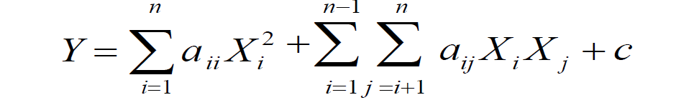
Results
Mathematical Model
All the aspects of analysis helped to understand, visualize and study the data which assisted in formulation of the proposed theoretical model. The model was determined by selecting the highest R square value. To support it, a mathematical model was also formulated –
Where, Y = Active Cases; X_{i} / X_{j} = Mobility parameter (Input parameters); a_{ii} / a_{ij} = Constants of equations from code ln [12]; c = intercept of line from code ln [12]; n = 8 (Input parameters)
Taking the India average value dataset, it can be concluded that Community Mobility and No. of Active Cases can be related by a 2nd degree relation. The same equation was also formulated from the Enumerated dataset with index for the user selected case of Nagpur.

Slide 35
References
[1] Jay Saha (2020), Lockdown for COVID-19 and its impact on community mobility in India: An analysis of the COVID-19 Community Mobility Reports, accessed from Lockdown for COVID-19 and its impact on community mobility in India: An analysis of the COVID-19 Community Mobility Reports, 2020 - ScienceDirect
[2] Rajan Gupta, Saibal K. Pal and Gaurav Pandey, A Comprehensive Analysis of COVID-19 Outbreak situation in India, accessed from (PDF) A Comprehensive Analysis of COVID-19 Outbreak situation in India (researchgate.net)
[3] Sarvam Mittal, Exploratory Data Analysis of COVID-19 in India, accessed from (PDF) An Exploratory Data Analysis of COVID-19 in India (researchgate.net)
[4] COVID-19 Epidemic: Unlocking the Lockdown in India from https://covid19.iisc.ac.in/wp-content/uploads/2020/04/Report-1-20200419-UnlockingTheLockdownInIndia.pdf
[5] Google Community Mobility Data, accessed from COVID-19 Community Mobility Reports (google.com)
[6] Covid India cases, accessed from Open Data - (covidindia.org)
[7] Covid 19 India, accessed from Coronavirus Outbreak in India covid19india.org
[8] Worldometer, accessed from India Coronavirus: 9,608,418 Cases and 139,736 Deaths - Worldometer (worldometers.info)
[9] Annexure to Ministry of Home Affairs from https://www.mohfw.gov.in/pdf/Annexure_MHA.pdf
[10] News Article: Ganpati celebration (Maharashtra) https://www.hindustantimes.com/mumbai-news/covid-19-rising-cases- dampen-festive-spirit-in-maharashtra/story-oDhbhoTz4oCt3iZZJxOK.html

